Slide 1
Dealing With Data
Class 1: Introductions, Class Overview, and Intro to Causality
As folks trickle in:
Make a nametag!
Try to sit next to someone you don’t already know.

Slide 2
Agenda
Welcome!
Course Overview
Causality

Slide 3
Welcome!

Slide 4
Let’s introduce ourselves!
Name
An academic interest
A non-academic interest

Slide 5
Hi! I’m Isaac!
Some academic interests:
Labor economics
Interested in the functioning of labor markets and related empirical methods
I’ve worked on questions about:
Minimum wages
Non-wage amenities
Equity in labor markets
...
Some non-academic interests:
Running
Wasting time online

Slide 6
Hi! I’m Mary!
Some academic interests:
Computer Science, Electrical Engineering, Math
Mostly on the theoretical side of things
Interested in questions like:
How do we compute/communicate reliably in noisy environments?
How do we efficiently and robustly answer questions about high dimensional data?
Some non-academic interests:
Being outside
Sci-fi novels
Board games

Slide 7
Let’s introduce ourselves!
Name
An academic interest
A non-academic interest

Slide 8
Course Overview!

Slide 9
Course Pitch
Data is everywhere!
We can do things with it!
Learn about the world
Predict things in the world
Make the world better!
There are things we can’t do with it! (Or shouldn’t)
Learn false things about the world
Make bad predictions
Cause global chaos
In this course we’ll learn how to do the good and how to avoid the bad!

Slide 10
Learning Goals
Understanding of the different ways of thinking about and using data
Proficiency with Python for data analysis
Proficiency with basic techniques
Experiments and quasi-experiments
Regression, Singular Value Decomposition, ...
Proficiency interpreting the results of those techniques

Slide 11
Course Philosophy
This course is designed to be approachable from all backgrounds
This course is interdisciplinary
This is a discussion class
You get out what you put in, and we’re here to help

Slide 12
Some Course Logistics
All course materials on Blackboard!
Including syllabus with more info
We meet once a week!
Attendance is part of your grade; you can miss two classes with a good reason, please reach out to us about it, ideally in advance.
Assignments!
Weeks 1-6: Five HW assignments
You can submit in pairs and collaborate broadly (please acknowledge your collaborators)
Weeks 7-10: Work on project!
You can submit in groups of up to four
Week 10: Project presentations
Office hours!
Mary: Wednesdays 1pm-2:30pm in ENG-168
Isaac: Thursdays 1pm-2:30pm in CASE-248

Slide 13
Homework 1 available at the end of class!
Installing Jupyter notebooks and crash course with Python
Exploring our first dataset!
IMPORTANT:
Try to get Jupyter notebooks up and running ASAP so we can help troubleshoot.
If you haven’t programmed in Python (or at all) before, HW1 may be overwhelming – it will get easier!!!
Please come to Mary’s Office Hours (Wednesday 1-2:30) for help!!
Or go to Isaac’s on Thursday, but Mary is more familiar with Python ☺ .

Slide 14
The Plan disclaimer: The Plan is subject to change
Is there a particular topic you really want to cover? (Within reason?) Let us know!
Class 1: Today!
What is causality?
Classes 2-4: Causal Inference
Actual and Natural Experiments, Instrumental Variables, etc
Class 5: Regression
Both the math and the many ways to interpret it
Class 6-7: Modeling linear and non-linear relationships in data
SVD, PCA, Random Forests, Neural networks, etc
Class 8-9: All sorts of data!
Art, music, text, …
Class 10: Project presentations
Start thinking about your projects!

Slide 15
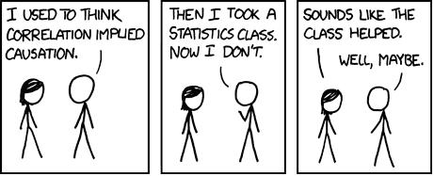
Causality!

Slide 16
Answering “causal” questions from data
What is the effect of going to college on future earnings?
What is the effect of campaigning on election results?
What is the effect of job training programs on earnings?
What is the effect of biases in training data on the output of classifiers?
What is the effect of monetary/fiscal policy on inflation?
What is the effect of taking this class on your understanding of causality?

Slide 17
Answering “causal” questions from data
What is the effect of going to college on future earnings?
What is the effect of campaigning on election results?
What is the effect of job training programs on earnings?
What is the effect of biases in training data on the output of classifiers?
What is the effect of monetary/fiscal policy on inflation?
What is the effect of taking this class on your understanding of causality?
What do any of these questions even mean???

Slide 18
For the rest of today’s class
We will survey several ways that people think about causality.
We will discuss pros and cons.
But first! Some examples.

Slide 19
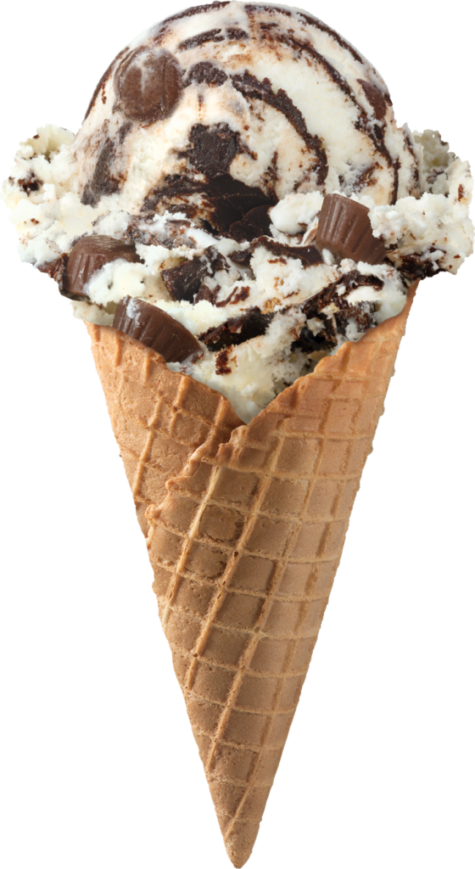
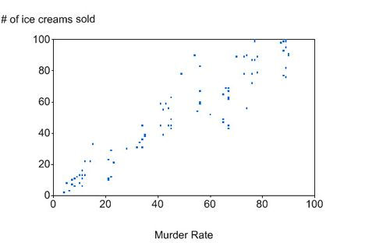
Ice Cream causes Homicide?
Apocryphal Fact: The more ice cream sales there are, the more homicides occur.
What’s going on?
Talk in small groups.
Apocryphal Data
Source: Google image search...

Slide 20
Possible issues with “Ice cream causes homicide”
Confounding variables: Third factors that influence both.
Confounding variables in this case might be:
Sunshine: When it’s sunny out, there are more ice cream sales, but also more daylight, which leads to more people out and about, which leads to…
Heat: When it’s warm out, there are more ice cream sales, but also more people are cranky because of the heat…
...
Ice cream sales
Heat
Homicides

Slide 21

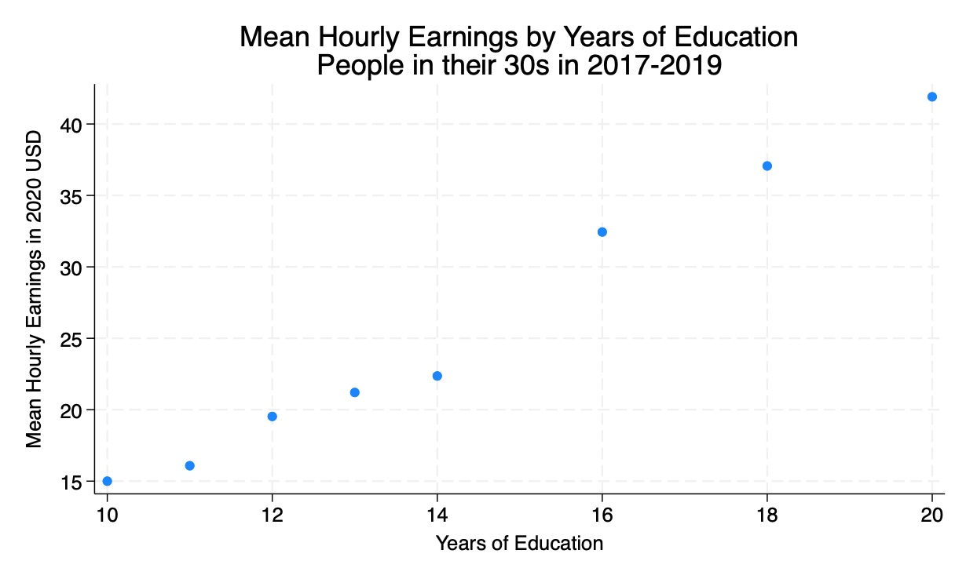
Education causes Earnings?
Fact: Education is correlated with higher earnings
Talk in small groups.
Do you think some of this is causal?
Do you think some of this is non-causal?
How do the causal/non-causal factors interact?
Current Population Survey

Slide 22
Possible Issues with “Education causes earnings”
On the one hand, there are a few clear mechanisms:
Education gives you skills
Education can be a signal
On the other hand:
Confounding variables
e.g. Parents’ income affects both whether you go to college and earnings later
Another way to say it: “Selection effects”
e.g., People who choose to go to college may be the sort of who will earn more later anyway, even if they hadn’t gone to college.

Slide 23

Flipping a light switch causes a light to turn on?
Number of lights that turned on
5
Okay, probably we understand what’s going on…but what makes this example different from the others?
4
3
2
1
1
2
3
4
5
Data source: we wandered around our house and flipped a bunch of switches
Number of light switches flipped up

Slide 24
What do we mean by causality?
Small groups:
Brainstorm at least two definitions of (or ways of thinking about/measuring) causality.
You don’t have to think they are “correct”!
What are the pros/cons of your definitions?

Slide 25
Ways of thinking about causality

Slide 26
A few ways of thinking about causality Disclaimer: we are not philosophers
Regularity-based accounts
Law-based accounts
Counterfactual/Manipulation-based accounts
Pass
Notes:
People have been thinking about causality since (at least) the ancient greeks (Aristotle, 4th c BCE), but we’re going to start our discussion in the 18th century with David Hume and “Regularity-based approaches”

Slide 27
The classics Disclaimer: We are not philosophers
Aristotle (4th c. BCE): Four types of causes:
Material: “Out of which the thing is made”
Formal: “Into which the thing is made”
Efficient: “What makes the thing”
Final: “For which the thing is made”
Locke (17th c. CE): A cause is a thing that “produces”. An effect is what is “produced”.
Hume (18th c. CE): We just say that X causes Y if X usually happens before Y.

Slide 28
A few ways of thinking about causality Disclaimer: we are not philosophers
Regularity-based theories
X causes Y if X is always/usually followed by Y.
Law-based theories
I know the laws of physics/nature/etc; they tell me what causes what.
Counterfactual/Manipulation-based theories
X causes Y if X is followed by Y, and if Y wouldn’t have happened without X.
Pass
Causality is just, like, a social construct, man
I’m agnostic about causality, I don’t need it to do what I want to do with data

Slide 29
Regularity-Based Accounts
Causality = Patterns

Slide 30
Regularity-based accounts of causality
Started with Hume (1739)
Hume: A “cause” is: [a]n object precedent and contiguous to another, and where all the objects resembling the former are plac’d in like relations of priority and contiguity to those objects, that resemble the latter.
Interpreted to mean that x causes y if:
x and y are “contiguous” (e.g., in space and time)
x precedes y in time
Things like x are typically followed by things like y
Refined by Mill (1843)
Remained a “standard” philosophical account until the 1970s or so.

Slide 31
Pros and Cons of (Hume-ian) regularity-based accounts
Pros:
Straightforward definition
Easy to see in data
Stanford Encyclopedia of Philosophy: Hume’s view is nice because “no substantive metaphysics is needed to explain causation.”
Cons:
Correlation doesn’t imply causation.
Ice cream sales may generally spike just before increased homicide
A rooster usually crows just before dawn
Doesn’t allow one-off events to be causal.
An asteroid hitting the earth caused the dinosaurs to go extinct.
Notes:
Longer version of the quote: “no substantive metaphysics is needed to explain causation. No entities like causal powers or a necessary connection between cause and effect need to be posited.”

Slide 32
Mill’s refinement
In addition to correlation, causation needs a “law of nature.”
What’s a “law of nature”?
Something simple, structural, and with predictive power.
E.g., Newtonian physics.
Examples:
The earth moving around the sun caused the sun to rise. (Physics says so).
A rooster crowing did not cause the sun to rise. (No “law of nature” that says so).
Notes:
Lewis’s summary/interpretation: “a contingent generalization is a law of nature if and only if it appears as a theorem (or axiom) in each of the true deductive systems that achieves a best combination of simplicity and strength”

Slide 33
Structure/Law/Inferential-Based Accounts
...segue to...
The laws of nature/logic/physics/etc determine causality

Slide 34
We already talked about Mill

Slide 35
Inferential Accounts (e.g., Ramsey, 1920’s...)
A caused B if, using what we believe about the world:
we can infer B from A; and
A happened before B
Examples:
When I drop an apple, it will fall (says Newtonian physics); so dropping the apple caused it to fall.
In my theory of the world/economy, more education gives you more skills which means you are worth more money which means people pay you more money. So going to college causes you to make more money.
Notes:
Note that in this view, ice cream would *not* cause homicide (unless we believe in a very strange model of the world), because there’s no reason we should infer homicide from ice cream.
Also related: the “kairetic account” of strevens (2000’s), which sort of says that A causes B if A is a “good explanation” for B.

Slide 36
Causal Model Approaches (e.g., Pearl, 2000)
If we have a structural model of the world, we can draw diagrams that represent what events can affect what other events.
One can do some math with these diagrams.
We won’t talk about this much in class.
Parents’ Income
Going to college
Parents’ education level
Income at age 30
Quality of pre-college education
Notes:
For example, if you believe that you can observe all of the important variables, you can sometimes infer causal structure from observational data alone.

Slide 37
Pros and Cons of structure/law/inferential accounts
Pros:
Solves some of the problems with regularity-based approaches.
Allows for “causality” to be a “real thing,” if you’re into that sort of thing.
Cons/Issues:
How do we know what the laws of nature are?
This can seem a bit circular.
Properties of (our current theories of) physics don’t play nice with some of these accounts:
Symmetry with respect to time
Non-Locality
Non-Determinism
Aka, causality is not just something that humans made up to talk about patterns.
Notes:
Another pro (of causal models) is that if you think you know all of the relevant variables, you can discriminate between causal models from observational data. Eg, X <- Y -> Z vs X -> Y -> Z, in the former X and Z should appear independent conditioned on Y, but this won’t be the case in the latter.

Slide 38
Counterfactual/Manipulation based approaches
It could have been different

Slide 39
Lewis’s Counterfactual Analysis (1973)
A causes B if:
If A happens, then B happens
If A didn’t happen, then B wouldn’t have happened
Example:
When I flip the switch, the light turns on. If I didn’t flip the switch, the light wouldn’t have turned on. Flipping the switch causes the light to turn on.
If the rooster hadn’t crowed, the sun would still rise. The rooster crowing did not cause the sun to rise.
Notes:
Fun fact: Lewis *doesn’t* explicitly put a time thing in his analysis. Instead, he argues that “If the light didn’t turn on, the switched wasn’t flipped” doesn’t mean that the light turning on ”caused” the switch to have been flipped because of “the time-asymmetry of overdeterminism”. I (Mary) don’t fully understand this, but perhaps this is referring to something like increasing branching/entropy (at least locally) with time? That is, “effects are rarely overdetermined by their causes, but causes are very often overdetermined by their effects.” For example, if Alice throws a rock at a window, there’s a whole constellation of effects: the window breaks, she no longer has the rock, her arm is in a throwing position, etc. But if the window breaks, there are lots of ways it could have broken, not just Alice throwing a rock.

Slide 40
Manipulation-Based Theories e.g., (Cook, Campbell, 1979), (Holland, Rubin, 1980’s)
A manipulation-based approach says that “If A didn’t happen” should be (at least in principle) possible to do.
“If I didn’t turn on the light switch” is possible to do
“If she wasn’t a woman” is harder to think about
Part of being her is how she has identified/been treated/perceived throughout her life.
Examples:
“Flipping the switch caused the light to turn on” makes sense.
“She is paid less because she is a woman” doesn’t make as much sense in this theory of causality.

Slide 41
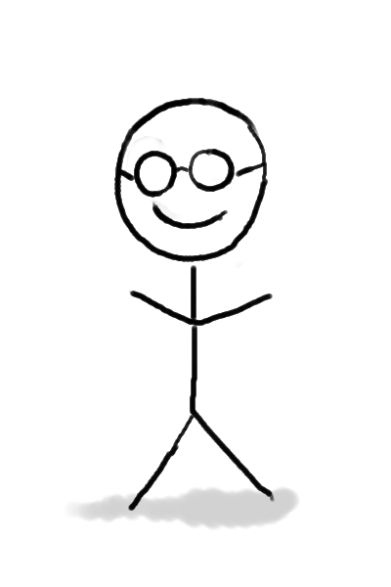

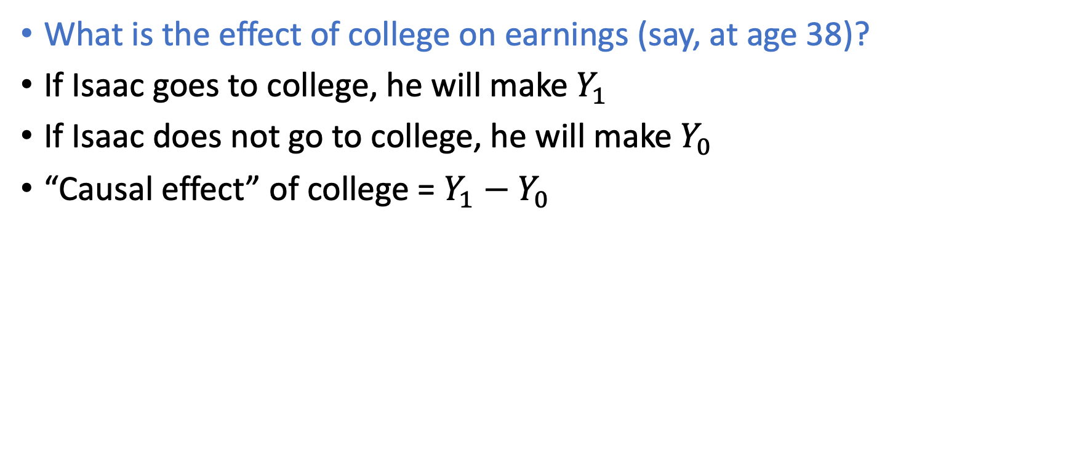
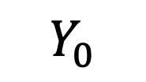
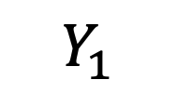
A smidge of notation: Potential Outcomes
What is the effect of college on earnings (say, at age 38)?
If Isaac goes to college, he will make $Y_{1}$
If Isaac does not go to college, he will make $Y_{0}$
“Causal effect” of college = $Y_{1}−Y_{0}$
One potential outcome
Another potential outcome
$$Y_{0}$$
$$Y_{1}$$
College-Abstaining Isaac
College-Going Isaac

Slide 42
How do we measure a causal effect?
Go back in time, and prevent 18-year-old Isaac from going to college.
Not super practical.
Look at lots of people who went to college and those who didn’t
That’s correlation! Not causation.
In a big population, randomize who goes to college and who doesn’t
This is a “randomized control trial”
For the effect of college on earnings, not necessarily possible/ethical
In a big enough population, claim that whether or not someone went to college was effectively random.
This is sometimes possible.

Slide 43
Issues with Counterfactual/Manipulation-based approaches to causality
We’re going to go with the “counterfactual/manipulation” definition for (at least) the first half of the course.
So we should take some extra time to talk about issues with it...
What are some issues?

Slide 44
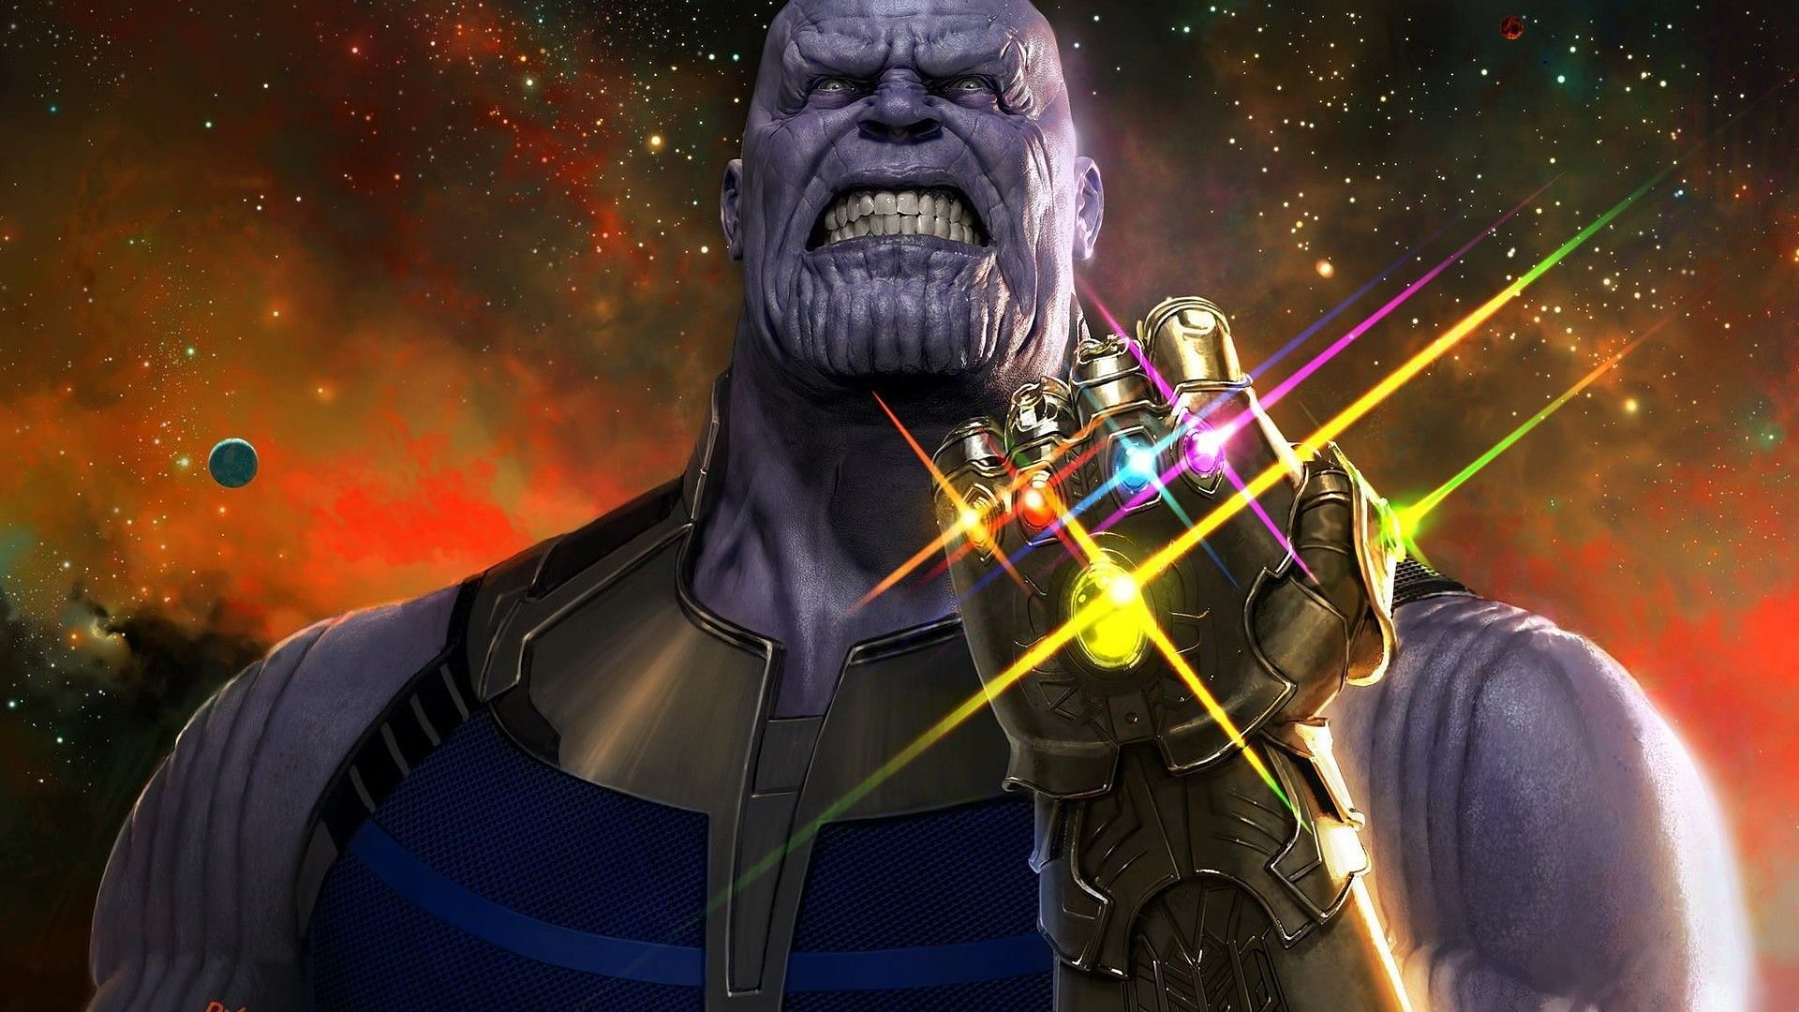
A few issues
Circularity of definition:
In order to manipulate X, I need to cause X to change.
Anthro-centric definition:
If a tree falls in the forest and no one was there to manipulate it, was it caused to fall over?
Certain things are ruled out as causes:
“The earth being round” cannot be manipulated.
The axioms of logic can’t be manipulated.
Arguably, intrinsic traits of individuals can’t be manipulated.
*
*By most people

Slide 45



A few more issues Illustrated by a thought experiment
Alice and Berk are throwing rocks at windows (don’t try this at home).
Easy version:
Alice throws her rock and breaks the window.
This caused the window to break, since if she hadn’t thrown it wouldn’t have broken.
But there are lots of less easy versions to think about…
These are interesting philosophically, and they can also point out places where non-philosophers need to be careful too.
Alice
Berk

Slide 46
Issues? Preemption; overdetermination
Alice and Berk are throwing rocks at windows (don’t try this at home).
Berk had told Alice that if she doesn’t throw, he will. Alice throws.
(Aside: related to “substitution bias”)
or Both threw rocks simultaneously, both hit the window.
Alice
Berk
Did Alice’s throw cause the window to break?
Notes:
Lewis’s answer to preemption is that the event that caused the window to break was Alice and Berk’s pact that at least one of them would throw a rock, not Alice’s throw.

Slide 47
Issues? Inaction as a cause?
Alice and Berk are throwing rocks at windows (don’t try this at home).
Neither threw the rock
or Alice threw but missed
Alice
Berk
Did Alice cause the window not to break?

Slide 48
Issues? Lots of things are required
Alice and Berk are throwing rocks at windows (don’t try this at home).
Alice threw the rock and broke the window
If Alice’s parents hadn’t met at a school dance in 1990, Alice wouldn’t have been born, and would not have broken the window.
Alice
Berk
Did the school dance in 1990 cause the window to break?

Slide 49
Issues? Lots of things are required
Alice and Berk are throwing rocks at windows (don’t try this at home).
Alice threw the rock and broke the window
If there weren’t oxygen on earth, Alice wouldn’t be alive to break the window.
Alice
Berk
Did oxygen cause the window to break?

Slide 50
Issues? Probabilistic relationships
Alice and Berk are throwing rocks at windows (don’t try this at home).
Alice
Berk
Alice aims and throws; there’s a 50% chance she’ll miss, and a 50% chance she will hit and break the window.
There’s a 25% chance that the window will spontaneously combust anyway.
If the window breaks, did Alice cause it?
If the window didn’t break, did Alice cause that?

Slide 51
Pass

Slide 52
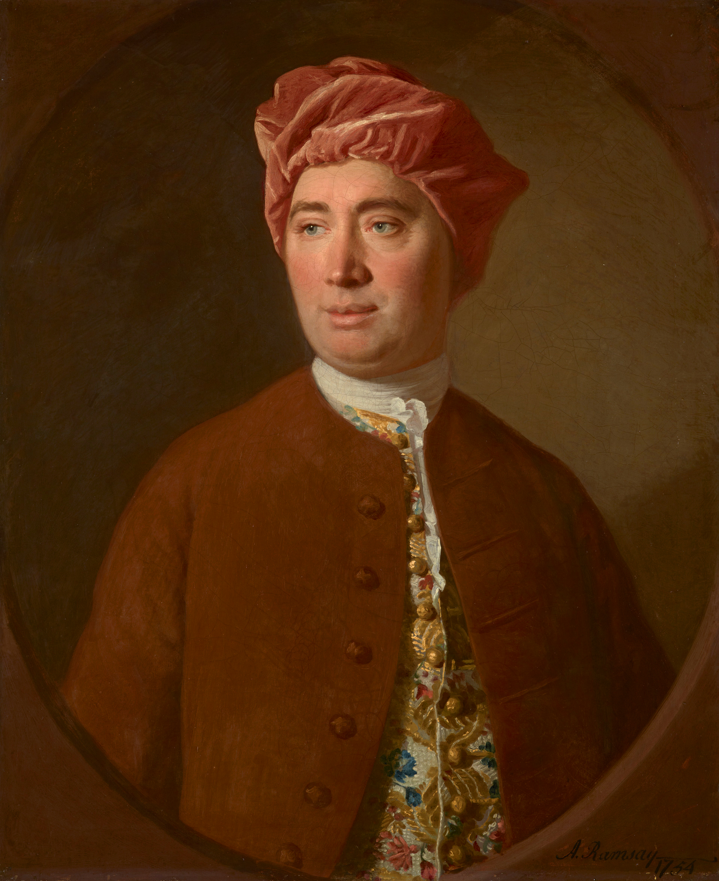
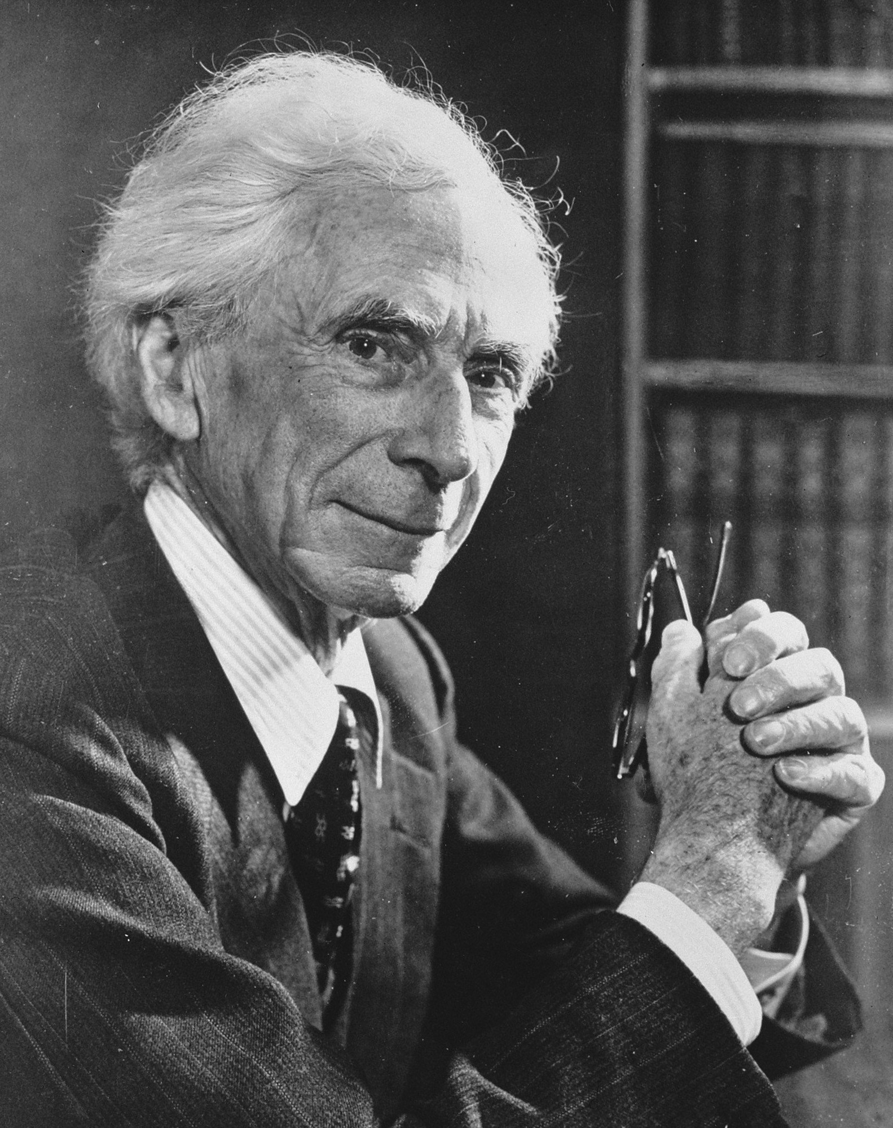
Philosophical notions of “Pass”
Is causality “real”?
“Causality” is just a word that humans use in order to describe regular patterns in data.
Causality is “a relic of a bygone age, surviving, like the monarchy, only because it is erroneously supposed to do no harm.”
David Hume
Bertrand Russell
Are some notions of causality “real,” but not others?
e.g., Some people think that “Education causes higher earnings” makes sense, but that “Isaac’s education caused him to make more money” does not.
If you like manipulation-based accounts: there is no way to see the counterfactual about Isaac in particular.
If you like regularity accounts: you need lots of examples to establish a pattern.
Note: some people think the opposite!
Notes:
e.g., Thomas Icard (Stanford philosophy prof) thinks that only general statements about causality (”type claims” rather than “token claims”) make sense.
Lewis 1973; Hausman 1998 say that token claims are the fundamental notion, and type claims are just a generalization of that.
Other sorts of things philosophers get worked up about: are causes/effects “events”? Or “facts”? (e.g., say that my neighbor Bob promises to water my plants and forgets; did Bob cause my plant to die through his inaction? And what about my neighbor Charlie who didn’t even know I was traveling but also failed to water my plants?)

Slide 53
Practical interpretations of “Pass”
Who cares about causality? Sometimes all we want to do is accurate prediction.
Neural networks can do handwriting recognition without knowing what “causes” something to look like the letter “A”.
LLMs (like ChatGPT) work by predicting what the next word should be, without a notion of what causes it.
If there are more ice cream sales, we may want to put more police on patrol.
If Alice and Berk are throwing rocks, we might want to go window-shopping.
Suppose we want to target a welfare program and don’t have access to earnings data. We may want to target folks with less education.
When Google trends sees lots of searches for “how to treat COVID?” we may want to take certain public health measures.
...

Slide 54
Pros and Cons Of “passing” on causality
Pros:
Don’t have to think too hard about causality*
Sometimes prediction is enough
Cons:
Don’t get to think hard about causality ☺
Sometimes we really do want to understand causes, especially if we are going to manipulate them.
If there are more ice cream sales, maybe more police should be on patrol.
But if we really understood what caused homicides, maybe we could make better policy.
*Unless you are “passing” for deep philosophical reasons

Slide 55
Recap and Wrap-Up

Slide 56
Recap: ways of thinking about causality
Regularity-based accounts
X causes Y if X is always/usually followed by Y.
Law-based accounts
I know the laws of physics/nature/etc; they tell me what causes what.
Counterfactual/Manipulation-based accounts
X causes Y if X is followed by Y, and if Y wouldn’t have happened without X.
Pass
Causality is just, like, a social construct, man
I’m agnostic about causality, I don’t need it to do what I want to do with data
1
2

Slide 57
Recap: Welcome to the course!
Course pitch:
Data is everywhere! Let’s use it well!
Learning goals:
Proficiency with Python and some analytic techniques
Proficiency interpreting what those techniques say
Course Philosophy:
We’re here for you! You get out what you put in, and we’ll help you do it.
Logistics:
Blackboard!

Slide 58
Assignment for next week!
Find it on Blackboard!
Part 1: Install Jupyter notebooks and do a quick Python tutorial
IMPORTANT! Try to do this ASAP, and come to Mary’s OH tomorrow if you need help.
Parts 2-4: Look into the effect of college on earnings!
Data from the Panel Study of Income Dynamics (PSID)
You’ll look at mean earnings among folks with a college education and without.
You’ll play around with the data to try to identify some possible issues with making causal claims.

Slide 59
That’s all! See you next week!

